Slide 1
Enhancing Time Series Momentum Strategies Using Deep Neural Networks
Wolfe 3rd Annual Virtual QES European Quant and Macro
Investing Conference
By Bryan Lim, Stefan Zohren & Stephen Roberts
University of Oxford
15 June 2020
Notes:
15s

Slide 2
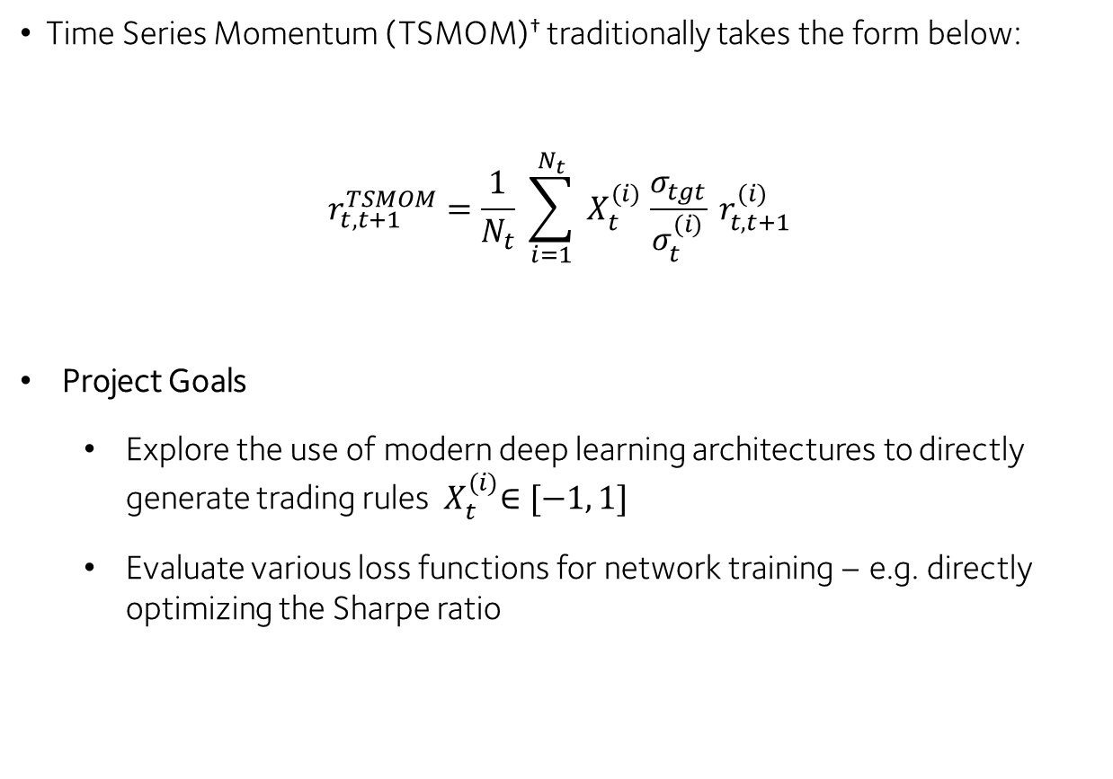
Time Series Momentum
Time Series Momentum (TSMOM)† traditionally takes the form below:
$$r_{t,t+1}^{TSMOM}=\frac{1}{N_{t}} \sum_{i=1}^{N_{t}}{{ X}_{t}^{(i)} \frac{σ_{tgt}}{σ_{t}^{(i)}} r_{t,t+1}^{(i)}}$$
Project Goals
Explore the use of modern deep learning architectures to directly generate trading rules ${ X}_{t}^{(i)}∈[−1, 1]$
Evaluate various loss functions for network training – e.g. directly optimizing the Sharpe ratio
† Moskowitz, Tobias J. and Ooi, Yao Hua and Pedersen, Lasse Heje, Time Series Momentum (September 1, 2011). Chicago Booth Research Paper No. 12-21; Fama-Miller Working Paper. Available at SSRN: https://ssrn.com/abstract=2089463

Slide 3


Time Series Momentum
Time Series Momentum (TSMOM)† traditionally takes the form below:
$$r_{t,t+1}^{TSMOM}=\frac{1}{N_{t}} \sum_{i=1}^{N_{t}}{{ X}_{t}^{(i)} \frac{σ_{tgt}}{σ_{t}^{(i)}} r_{t,t+1}^{(i)}}$$
Project Goals
Explore the use of modern deep learning architectures to directly generate trading rules ${ X}_{t}^{(i)}∈[−1, 1]$
Evaluate various loss functions for network training – e.g. directly optimizing the Sharpe ratio
Trading Rule for Asset $(i)$
Overall
Strategy Return
Daily (t to t+1) Return of Asset $(i)$
Number of
Indiv. Assets
Volatility Scaling
† Moskowitz, Tobias J. and Ooi, Yao Hua and Pedersen, Lasse Heje, Time Series Momentum (September 1, 2011). Chicago Booth Research Paper No. 12-21; Fama-Miller Working Paper. Available at SSRN: https://ssrn.com/abstract=2089463
Notes:
2mins

Slide 4
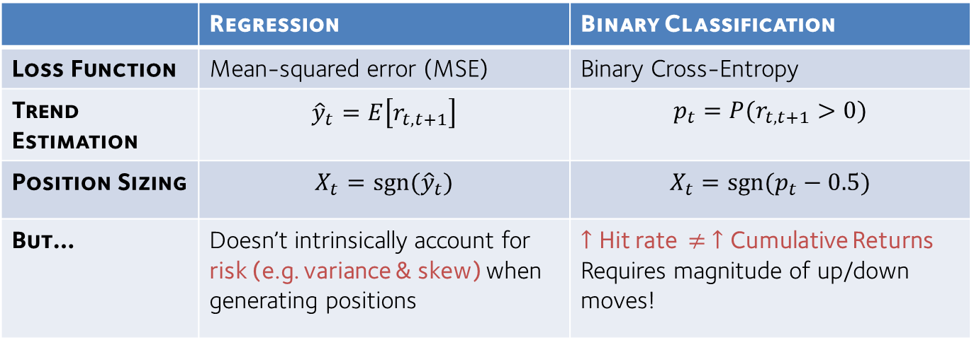



Possible Approaches With Standard Methods
Basic TSMOM
Step 1: Trend estimation
${\hat{y}}_{t}=r_{t−252, t}$ (i.e. past year returns)
Trading Rule${ X}_{t}^{(i)}$
Step 2: Position Sizing
$X_{t}=sgn⁡({\hat{y}}_{t}$)
Standard Supervised Learning Methods
 | Regression | Binary Classification
Loss Function | Mean-squared error (MSE) | Binary Cross-Entropy
Trend Estimation | $${\hat{y}}_{t}=E\left[r_{t,t+1}\right]$$ | $$p_{t}=P(r_{t,t+1}>0)$$
Position Sizing | $$X_{t}=sgn⁡({\hat{y}}_{t})$$ | $$X_{t}=sgn⁡(p_{t}−0.5)$$
But… | Doesn’t intrinsically account for risk (e.g. variance & skew) when generating positions | $↑$ Hit rate $≠ ↑$ Cumulative Returns Requires magnitude of up/down moves!
Notes:
4-6mins
Trading rules are split into 2
Standard supervise learning fits nicely into step 1
But they don’t account for risk & hit rate doesn’t necessarily correlate with good signals
In addition, position sizing still needs to be specified here.
This motivates the need for new signals that use both trend and risk information to size positions, and learn position sizing in a data driven fashion.

Slide 5
Deep Learning Architecture Design
Notes:
With that in mind, let’s dive into our deep learning architecture design

Slide 6

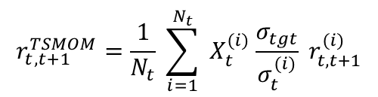

Hybrid Approach
Parameterised by network outputs
$$r_{t,t+1}^{TSMOM}=\frac{1}{N_{t}} \sum_{i=1}^{N_{t}}{{ X}_{t}^{(i)} \frac{σ_{tgt}}{σ_{t}^{(i)}} r_{t,t+1}^{(i)}}$$
Defined Quantitative Model:
Linear
Activation Function
Output Layer
Encoded Feature Vector $h_{t}^{(i)}$
Recurrent Neural Network
Convolutional Neural Network
Encoder Layer
Historical Data (time $t$, asset $i$)
Notes:
We adopt a hybrid approach, which uses DNN outputs to parameterise well-studied quantitative models.
Reduces the hypothesis space of the model, improving generalisation
Retain known desirable attributes of the model – i.e. volatility scaling in this case
Our model can be decomposed into two – at the base, we have an encoder layer which summarises past information into a single feature vector h_t. This is then mapped to our trading rule via an output layer – consisting of a linear transformation passed through an activation function to ensure the validity of th trading rule.

Slide 7

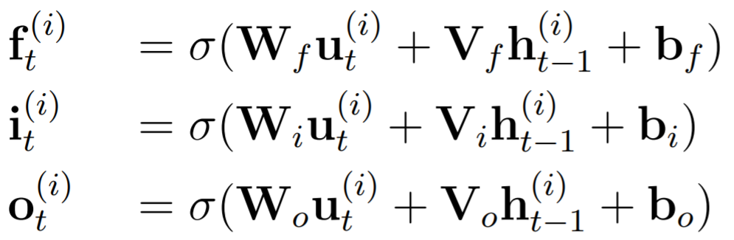
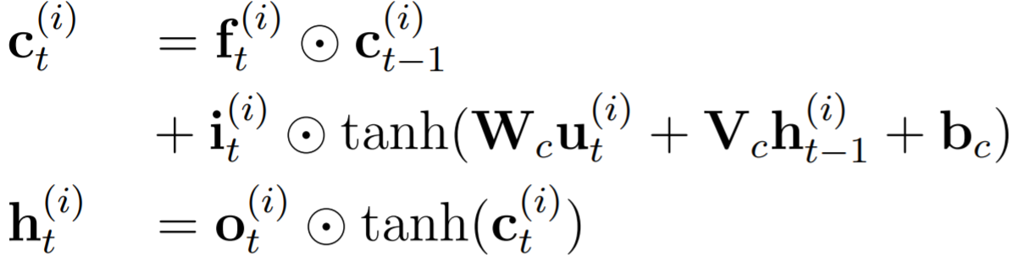








Encoder Architectures - RNN
Long Short-Term Memory (LSTM) Network
$$i_{t}$$
Nonlinear Processing
$$c_{t}$$
$$h_{t}$$
$$u_{t−1 }$$
$$u_{t }$$
$$f_{t}$$
$$o_{t}$$
$$u_{t }$$
LSTM Gates
Internal Memory
Forget
Input
Output
Cell State
Hidden State
Sigmoid Activation
Image Src: http://colah.github.io/posts/2015-08-Understanding-LSTMs/
Notes:
Recurrent neural network model popularised in natural language processing.
RNNs in general use information at each time step to update internal memory states, which are then used to generate predictions
For the LSTM architecture, we have two types of internal memory. Cell state – long term, hidden state short term.
Hidden and cell states are maintained by a series of gates which we see on the left

Slide 8
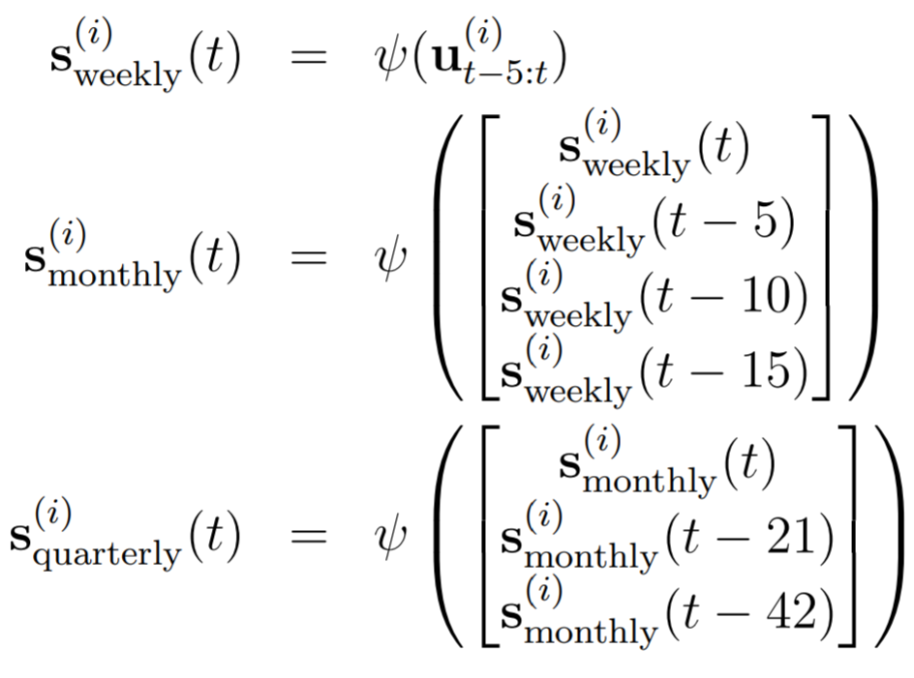
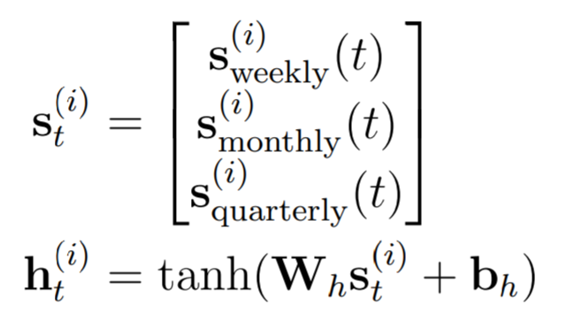
Encoder Architecture - CNN
WaveNet – Dilated Convolutional Neural Network
Convolutional filters at different time scales
Aggregated to encoded latent features
Image Src: https://deepmind.com/blog/article/wavenet-generative-model-raw-audio
Notes:
Dilated convolutional network developed for text-to-speech generation by DeepMind in 2016, and commonly adopted in other time series forecasting architectures.
Convolutional filters are applied at increasing time scales.
Aggregated features at different levels are all used to encode latent features
In comparison to RNN, large model with more params & hyperparams

Slide 9
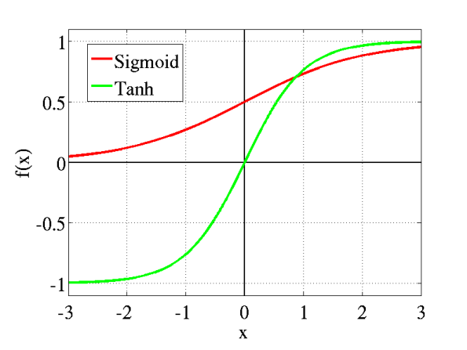
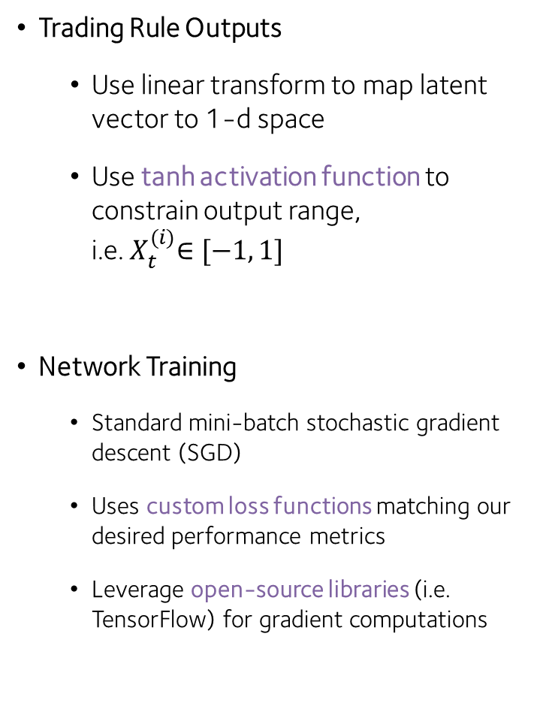
Output Layer
Trading Rule Outputs
Use linear transform to map latent vector to 1-d space
Use tanh activation function to constrain output range, i.e.${ X}_{t}^{(i)}∈[−1, 1]$
Network Training
Standard mini-batch stochastic gradient descent (SGD)
Uses custom loss functions matching our desired performance metrics
Leverage open-source libraries (i.e. TensorFlow) for gradient computations
Tanh vs Sigmoid Activations

Slide 10
Machine Learning-based Trading Rules
Encoders
Trading Rules
Lasso Regression
2-layer MLP
LSTM
Wavenet (Dilated CNN)
Inputs
Regression
Classification-based
Direct Rules
$X_{t}=sgn⁡(E[r_{t+1}])$
𝑋_𝑡=sgn⁡(E[𝑟_(𝑡+1)])
$X_{t}=\operatorname{sgn}{(Pr\left(r_{t+1}>0 \right)−0.5)}$
𝑋_𝑡=sgn⁡〖(Pr(𝑟_(𝑡+1)>0 )−0.5)〗
Calib. Metrics
Normalised Returns
MSE
Sharpe Ratio
Ave. Returns
Binary X-Entropy
Regression
Classification-based
Direct Rules
$X_{t}=\tanh{(Z_{t})}$
𝑋_𝑡=tanh⁡〖(𝑍_𝑡)〗
Inputs per Baz et al. 2015 †
MACD Indicators
1d, 1m, 3m, 6m, 1y returns - scaled by 3m EWM Vol.
(8, 24), (16, 48) & (32, 96) X-overs
Vol. scaled per their methodology, but not sized
† Baz, Jamil and Granger, Nicolas and Harvey, Campbell R. and Le Roux, Nicolas and Rattray, Sandy. Dissecting Investment Strategies in the Cross Section and Time Series (December 4, 2015). Available at SSRN: https://ssrn.com/abstract=2695101
Notes:
- With the individual model components in mind, the entire flow of trading rule generation is summarised on this slide.
- First we start with inputs

Slide 11
Backtest Results
- Pre-Costs

Slide 12
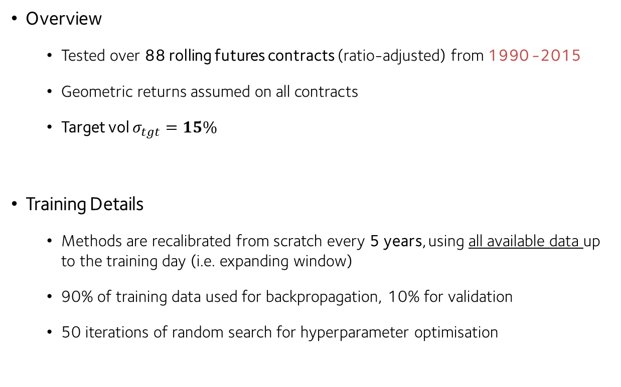
Backtest Description
Overview
Tested over 88 rolling futures contracts (ratio-adjusted) from 1990 -2015
Geometric returns assumed on all contracts
Target vol $σ_{tgt}=15\%$
Training Details
Methods are recalibrated from scratch every 5 years, using all available data up to the training day (i.e. expanding window)
90% of training data used for backpropagation, 10% for validation
50 iterations of random search for hyperparameter optimisation

Slide 13
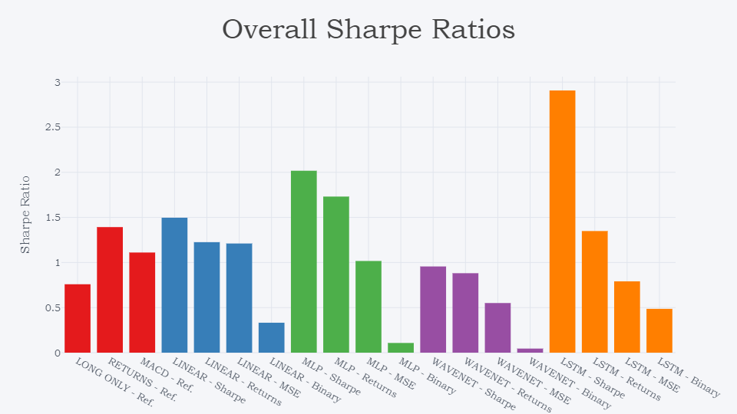
Sharpe Ratios (1995-2015)
Notes:
First, let’s take a look at the portfolio sharpe ratios over the entire backtest period.
Key thing that jumps out is the great out-performance of sharpe-optimised models - indicating efficacy of risk-adjusted performance optimisation.
The next thing to notice is that WaveNet under-performs regardless, indicating

Slide 14
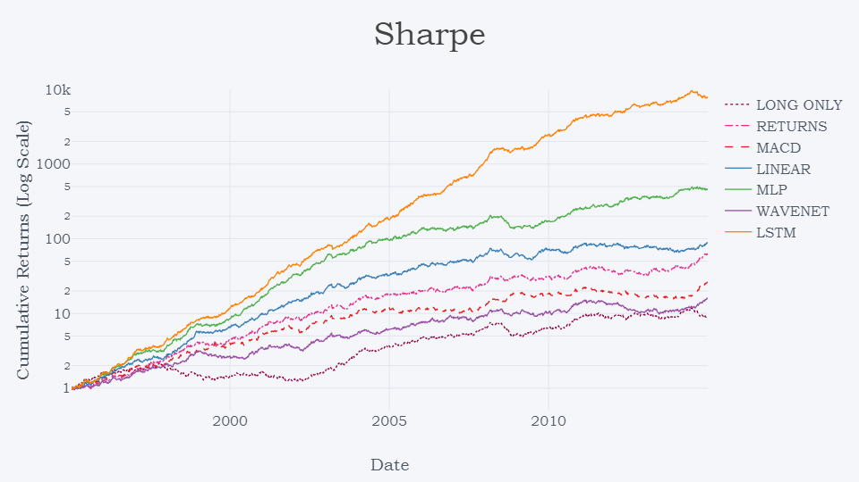
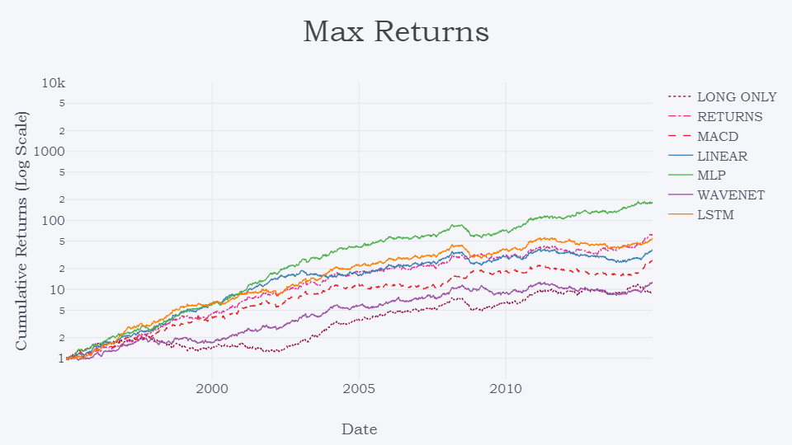
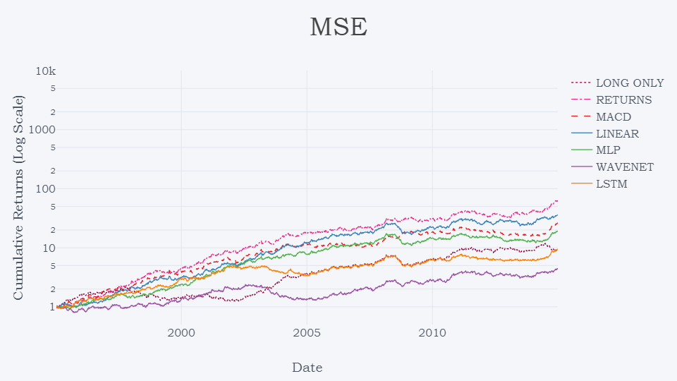
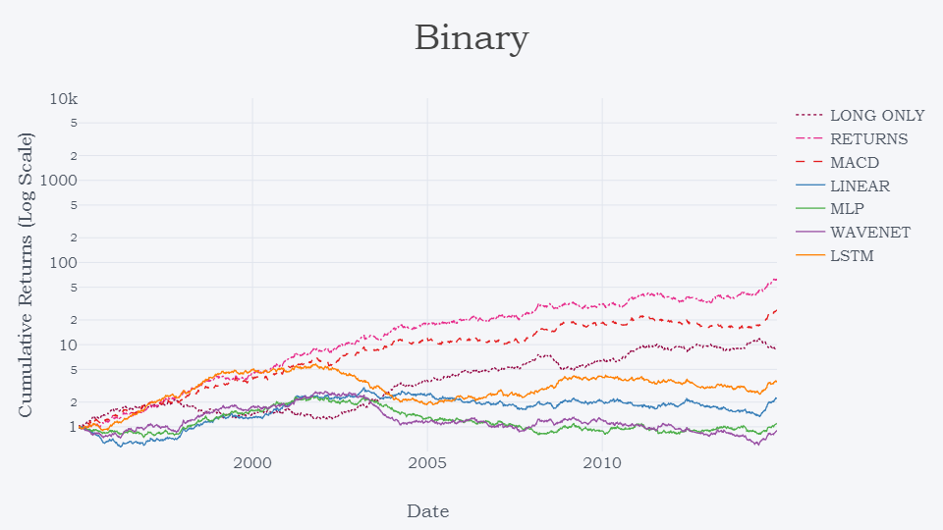
Cumulative Returns (1995-2015)
Notes:
Next, considering the cumulative returns, and here we have them all grouped according to loss function instead + on the same scale
Maximising returns gives similar performance vs benchmarks
Underperformance of MSE and binary for machine learning models – lack of risk information

Slide 15
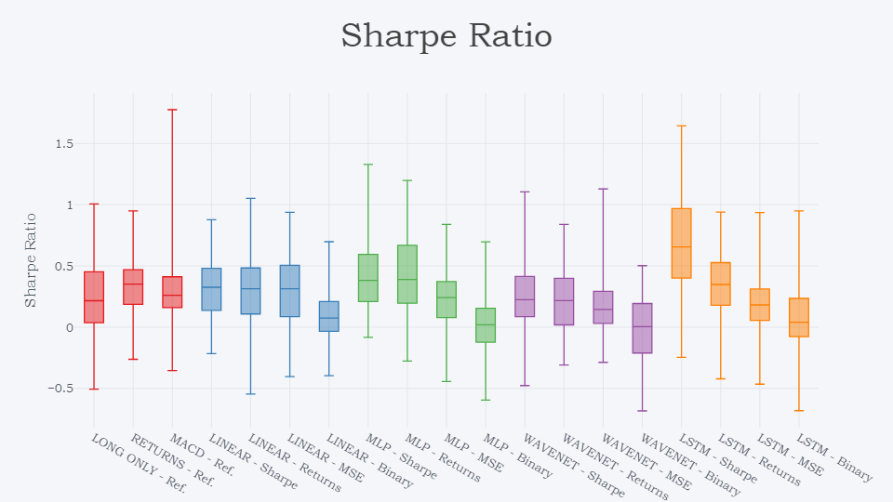
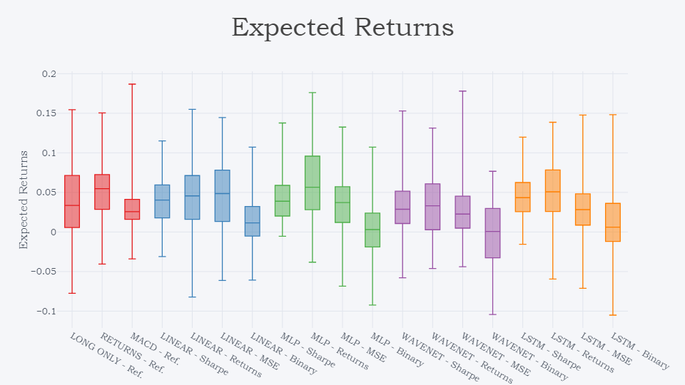
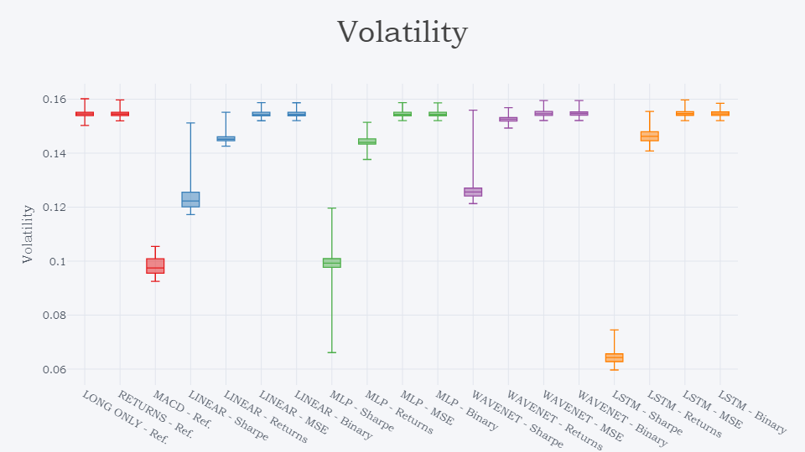
Asset Level Risk vs Reward
Notes:
Sharpe ratios are quite as expected, LSTM side
However, when we analyse asset-level average returns and volatility provides a deep insight into the nature of our signals.
Looking at expected returns, we see that models trained to maximise returns do have a larger mean return than Sharpe-optimised models, but Sharpe-optimised models vastly reduce the volatility of individual asset returns.
Means that optimising Sharpe provides a finer level of risk control, and improves beyond pure volatility scaling.

Slide 16
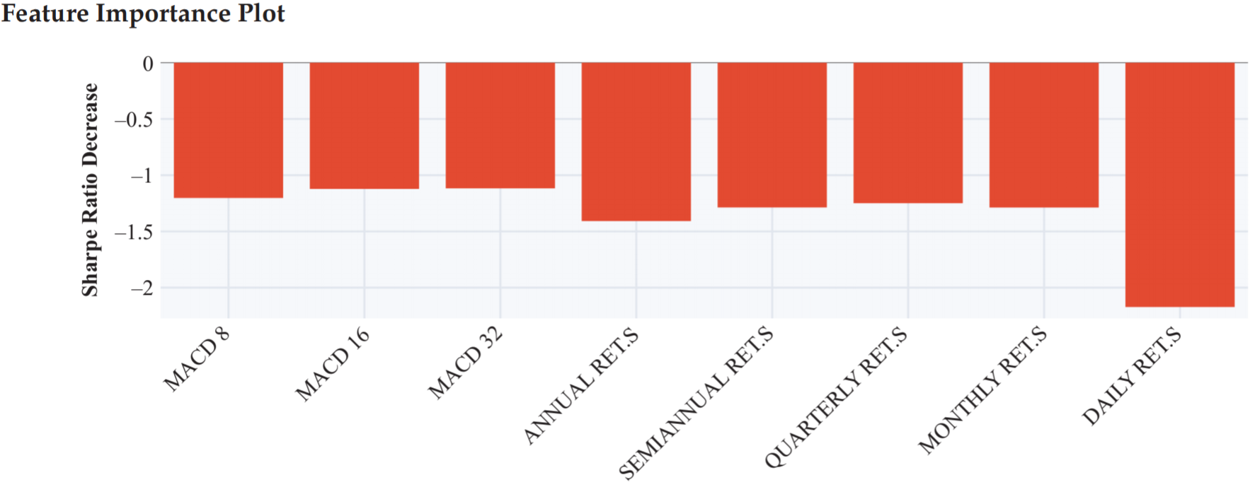
Feature Importance Analysis
Methodology
For a given feature, set values across all time to 0
Re-run backtest and evaluate changes in results
Results
Notes:
Another interesting analysis is in which feature is most important
Means that model is directly learning additional characteristics not present in the hand-crafted features, indicting importance of DL

Slide 17
Incorporating Transaction Costs

Slide 18
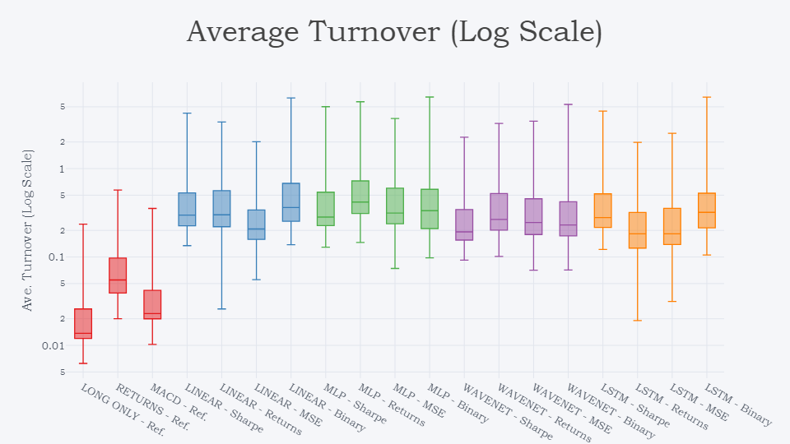
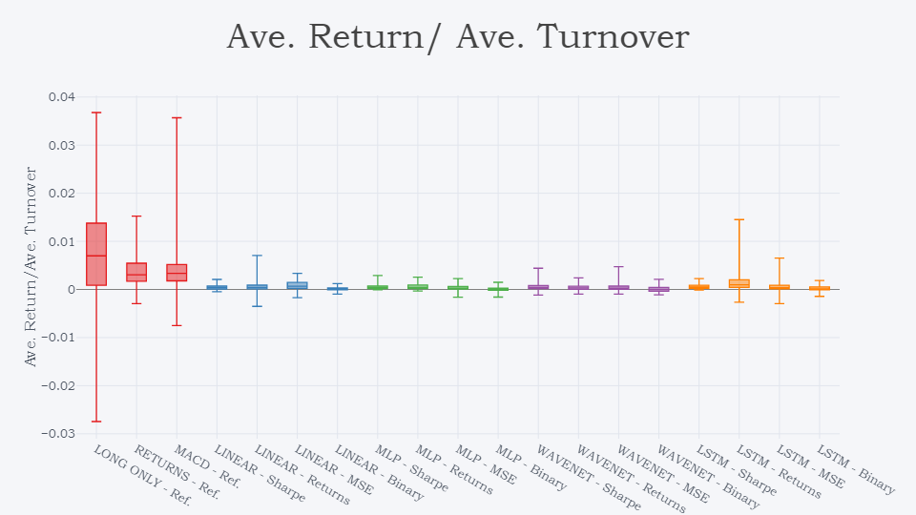
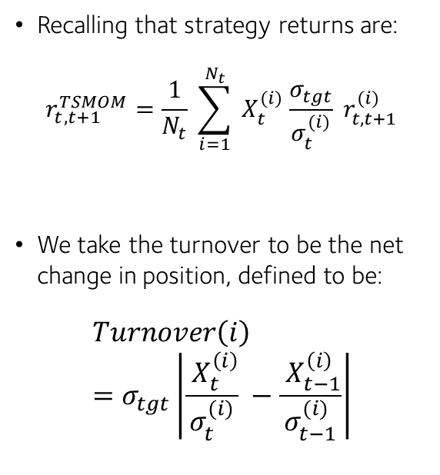
Turnover Analysis
Recalling that strategy returns are:
$$r_{t,t+1}^{TSMOM}=\frac{1}{N_{t}} \sum_{i=1}^{N_{t}}{{ X}_{t}^{(i)} \frac{σ_{tgt}}{σ_{t}^{(i)}} r_{t,t+1}^{(i)}}$$
We take the turnover to be the net change in position, defined to be:
$$Turnover\left(i\right)=σ_{tgt}\left|\frac{{ X}_{t}^{\left(i\right)}}{σ_{t}^{(i)}} −\frac{{ X}_{t−1}^{\left(i\right)}}{σ_{t−1}^{(i)}}\right|$$
Notes:
To gauge the effect on transaction costs, we do a deep analysis on the average turnover of the signal itself.
Recalling that the weight per asset is given by trading rule and vol scaling, we define the net turnover to be magnitude of the change in weights form one time step to the next
Looking at the

Slide 19
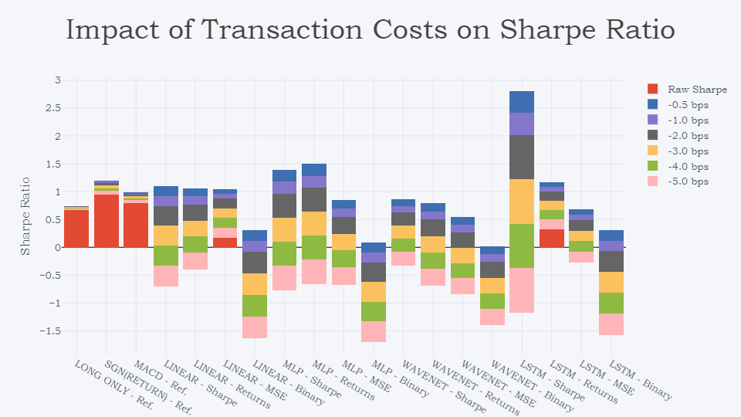
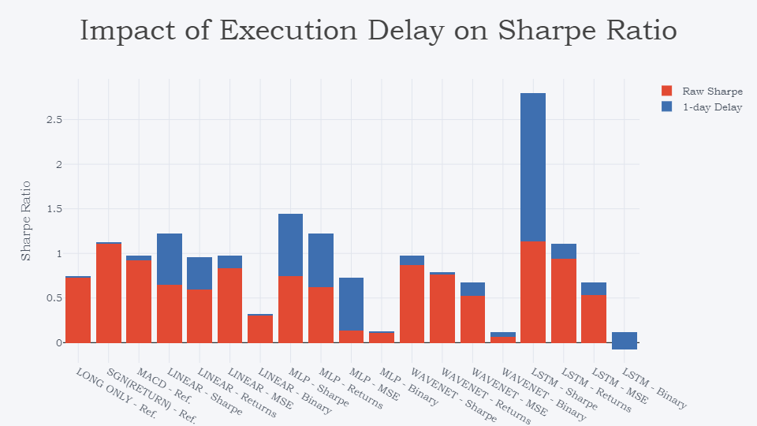
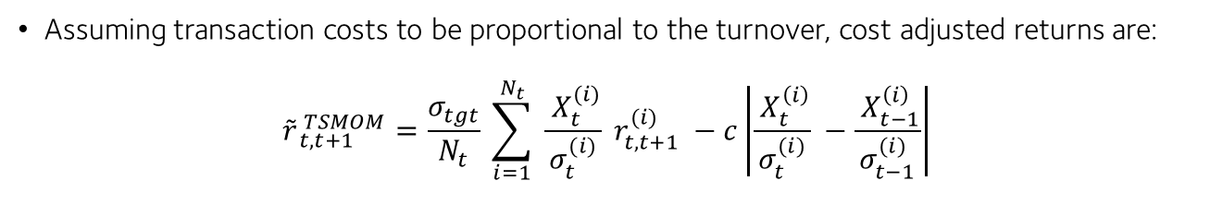
Impact of Slippage
Assuming transaction costs to be proportional to the turnover, cost adjusted returns are:
$${\tilde{r}}_{ t,t+1}^{ TSMOM}=\frac{σ_{tgt}}{N_{t}} \sum_{i=1}^{N_{t}}{ \frac{{ X}_{t}^{(i)}}{σ_{t}^{(i)}} r_{t,t+1}^{(i)}} −c\left|\frac{{ X}_{t}^{\left(i\right)}}{σ_{t}^{(i)}} −\frac{{ X}_{t−1}^{\left(i\right)}}{σ_{t−1}^{(i)}}\right|$$

Slide 20
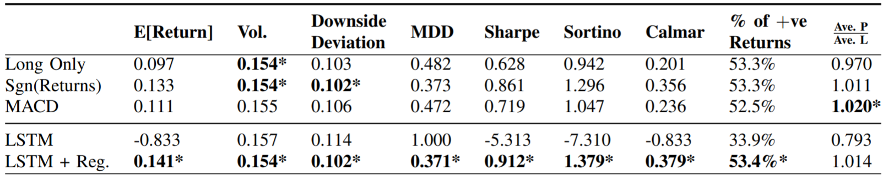
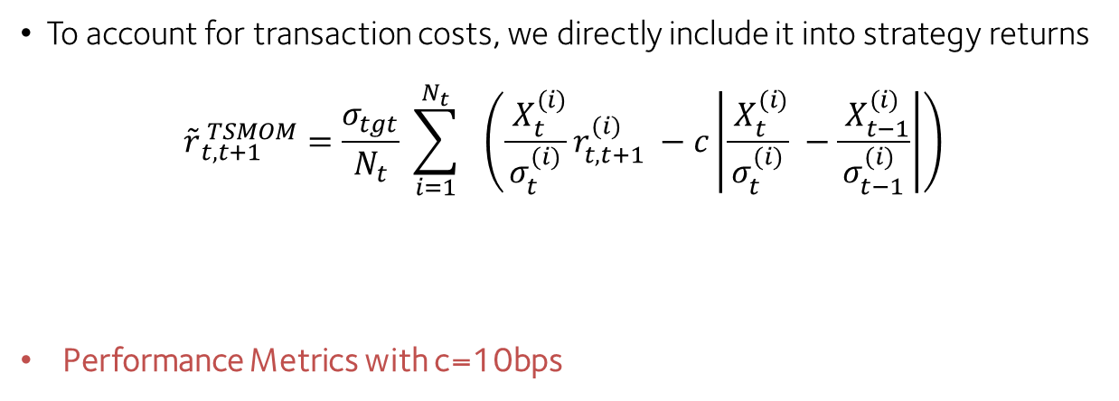
Turnover Regularisation
To account for transaction costs, we directly include it into strategy returns
$${\tilde{r}}_{ t,t+1}^{ TSMOM}=\frac{σ_{tgt}}{N_{t}} \sum_{i=1}^{N_{t}}{ } \left(\frac{{ X}_{t}^{(i)}}{σ_{t}^{(i)}}r_{t,t+1}^{(i)} −c\left|\frac{{ X}_{t}^{(i)}}{σ_{t}^{(i)}} −\frac{{ X}_{t−1}^{(i)}}{σ_{t−1}^{(i)}}\right|\right)$$
Performance Metrics with c=10bps
Turnover Regulariser

Slide 21
Conclusions

Slide 22
Conclusions
Hybrid deep learning approach to enhance time series momentum strategies
Learns trading rules directly from data - simultaneously combining trend estimation and position sizing functions
Networks trained by optimizing desired performance metric (i.e. the Sharpe Ratio)
Backtest results show that the best performance arises from Sharpe ratio-optimized LSTMs, although signal turnover is high
Networks can be trained to factor in transaction costs via turnover regularization

